Slide 1
Provider - 3.0
Sean G. Boynes, DMD, MS
Director of Interprofessional Practice

Slide 2
Team Based Care Delivery

Slide 3
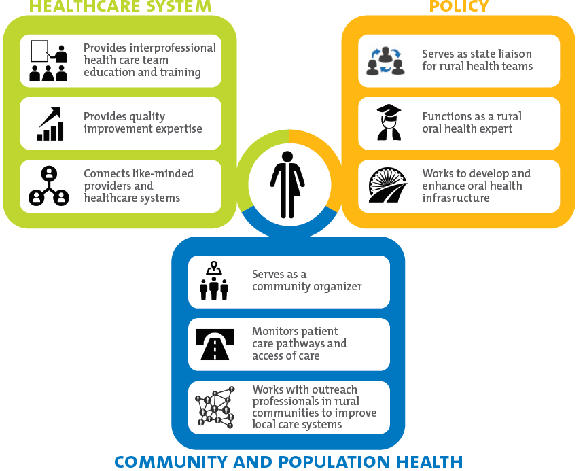
Notes:
Responsibilities grow

Slide 5
FTE - Positive Time Management
Blue et al. (2013): Expanded duty hygienists and assistants are underutilized according to maximum legal ability, although they have a positive impact on dental care quality.
FTE (Full time equivalent hours worked by an employee) positive time management includes placement and usage of personnel according to highest level of licensure/training
Core of this methodology: optimizing the time of the most costly (and usually most profitable) provider
Many safety net dental and group practice models have adopted this prototype, resulting in improved capacity, patient satisfaction and happier clinicians

Slide 6
Primary Prevention | Secondary Prevention | Tertiary Prevention
 |  | Primary Care | Specialty
Dietary counseling Behavior modification Fluoride varnish Dental sealant | Remineralization | Restorations Pulpotomy Simple endodontics Simply extractions | Endodontics Perio surgery Complex prosthodontics Oral surgery Orthodontics
Dental Assistant $17.13 Medical Assistant $14.80 Nursing Assistants $12.51 Dietetic Tech $13.74 | Dental Hygienist $34.39 Physician Assistant $45.36 Nurse Practitioner $45.71 | General Dentist $79.12 Pediatric Dentist | Oral Surgeon $105.27 Orthodontist $94.36 (not all specialists had income captured by BLS)

Slide 7
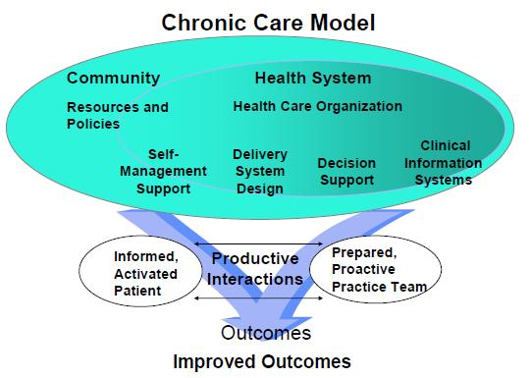
Team based care delivery model
Lack of knowledge and experience in using enhanced function auxiliaries within a team based delivery model
Need to improve socialization of team based models
Notes:
At end of day it is really about efficient time management and practicing at the highest level of training which provides pathways to challenging tasks
Success in patients self managing when team based care is employed

Slide 8
New Members and Methodologies
New methodologies continue to be proposed that extend the impact and access of oral health practitioners.
For underserved areas and populations, these approaches can offer access to care pathways that were previously incomplete and perform better coordination of care.
The use of public health dental hygiene practitioners as medical team members
Community dental health coordinators,
Virtual dental home

Slide 9
PHDHP and the Medical Team
Pennsylvania created the Public Health Dental Hygiene Practitioner (PHDHP) in December 2009.
The additional PHDHP licensure allows for practice without the supervision of a dentist in select practice sites, including FQHCs and Rural Health Clinics.
Dental hygienists in underserved environments have been reported to positively affect outcomes by offering preventive services and care coordination for needed dental care.
In several areas of the state, the PHDHP works in a co-located operatory, or space, within the pediatric medicine practice
Coordinating oral health care for pediatric patients, to coincide with their medical well child visits, and managed the dental care referral process.
Notes:
Dental hygienists in underserved environments have been reported to positively affect outcomes by offering preventive services and care coordination for needed dental care.⁶⁹⁻⁷⁰

Slide 10
Virtual Dental Home (VDH)
VDH is a community-based care delivery system using telehealth to link specialty trained hygienists in the community with participating dentists.
Practitioners use a store-and-go format to capture an individual’s oral health record for review by dentists.
A specially trained advanced practice practitioner collects the electronic dental records (health history, intra- and extra- oral pictures, radiographs, and tooth charting) using portable or mobile equipment.⁷²
The information is uploaded to a secure Internet system where the supervising dentist can evaluate the record, create a treatment plan and provide care guidance.
A six-year report on the UP-Arthur Dugoni School of Dentistry’s VDH program found that a majority of children involved in the program can have oral health needs met by dental hygiene providers via VDH, no adverse outcomes were reported, and the system delivered more prevention and early intervention at less cost per patient.

Slide 11
Community Dental Health Coordinators (CDHCs)
CDHCs are members of the dental care team who work in underserved communities to improve access and oral health.
After formalized training, they provide a limited range of preventive care, serve as referral coordinators assisting patients in making and keeping dental care appointments, and lead oral health initiatives in their communities.
CDHC pilot project reported increases in:
Total number of procedures by the entire dental care team
Total value of care performed
0% broken appointment rate by diabetic patients
Notes:
Following a formal training program,

Slide 12
Provider and Staff Development
Analyses to measure strengths and weakness
Subjective
Objective
Performance Improvement
Developing clinic and front office benchmarks or averages
Team based success and failures
Shared responsibility
Mixed results with incentive programs
The type of program must be a win - win
Notes:
Subjective leadership attributes
Objective performance with data
Culture of team achievement

Slide 13
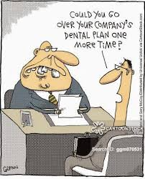
Questions & Discussion

Slide 14
Better IPP Communication and Referral Process

Slide 15
The Importance of the Referral Process
Evidence reveals:
Strong referral system =
Patient satisfaction
Patient outcomes
Practice viability

Slide 16
HRSA and Oral Health Referral
HRSA set forth the following competencies for coordination of interprofessional oral health care:
exchange meaningful information that benefits care delivery
apply patient and population- centered interprofessional practice principles; as well as,
facilitate patient navigation and provide appropriate referrals.
HRSA also advises medical provider teams to consider a dental care referral “…equal to a referral to any other type of specialist.”
And vice versa!!!
US Department of Health and Human Services. Integration of oral health and primary care practice. 2014.
US Department of Health and Human Services. Considerations for oral health integration in primary care practice for children. 2012.

Slide 17
Problems with the Referral Process
Obstacles to a comprehensive IP referral process include:
Provider time constraints,
Difficulty in maintaining continuity of care (repeated diagnostic procedures and testing)
Communication failure
Lack of EHR/PMS interoperability,
Low oral health literacy
Patient’s lack of insurance coverage or means of payment
Transportation and child-care limitations
Notes:
Disease management often referred to as the “medical model”
Areas of overlap between population health designs.
Interprofessional care

Slide 18
Current Referral Use…
ADA Health Policy Institute
Found that a significant disconnect exists between medical and dental care referral systems.
Physicians who participated in the analysis stated an overall dissatisfaction with the current process
Electronic Referral Process
When primary care teams used an electronic referral tool, the receipt of timely patient information between the referral partners was three times higher compared to non-electronic
FQHC Dental Referral
Patients were surprised by the high level of IPP provider communication and preferred the IPP process to previous care experiences.
Medical providers stated that they felt more empowered to address oral health needs with a dental care referral network in place.

Slide 21
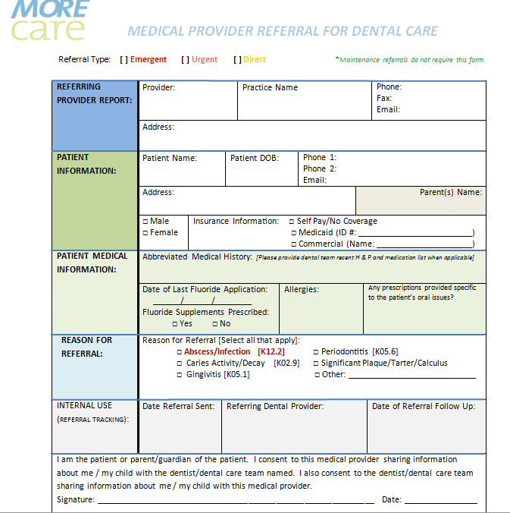

Slide 22
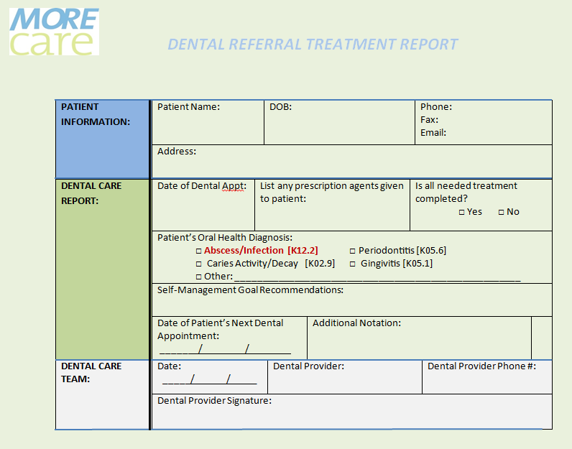

Slide 23
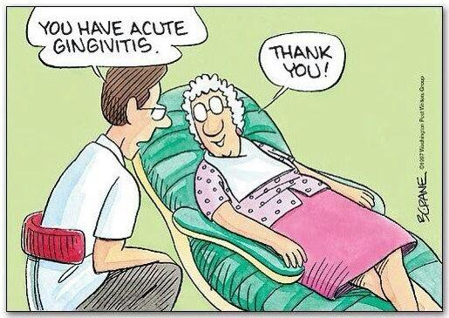
Questions & Discussion

Slide 24
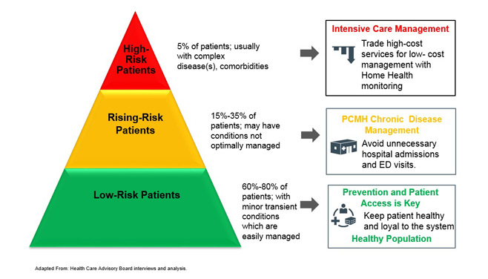
Risk Stratified Care and Population Health

Slide 25
What are Disease Management Models?
Disease management is a system of coordinated health care interventions and communications for populations with conditions in which patient self-care efforts are significant.
Prevention focused
Interprofessional/Integrated care (overlap)
Population health
Notes:
Disease management often referred to as the “medical model”
Areas of overlap between population health designs.
Interprofessional care

Slide 26
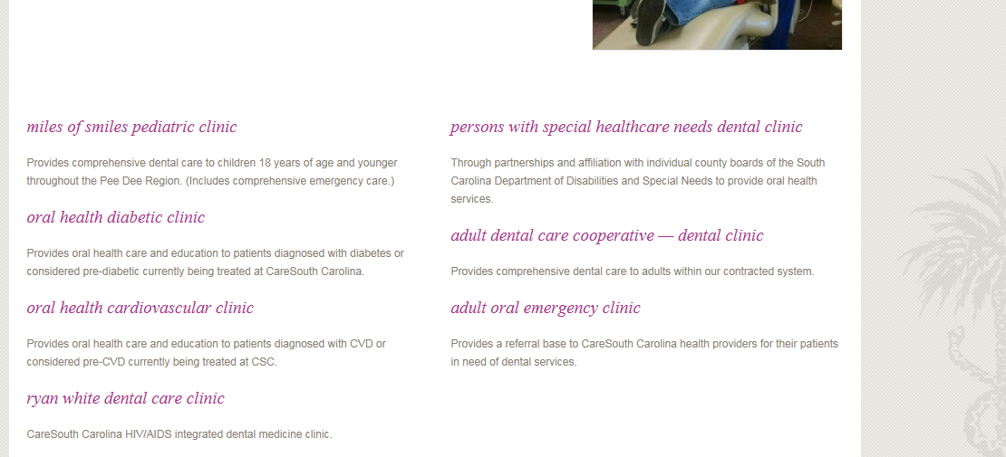
Organizing Populations for Care
Notes:
Think about how to produce better outcomes for patients identified by risk
Mixes well with the disease management model of care

Slide 27
Risk Stratified Care Management
American Academy of Family Physicians
“Risk-stratified care management (RSCM) is the process of assigning a health risk status to a patient, and using the patient’s risk status to direct and improve care. The goal of RSCM is to help patients achieve the best health and quality of life possible by preventing chronic disease, stabilizing current chronic conditions, and preventing acceleration to higher-risk categories and higher associated costs”
Notes:
Used as a means to take on population health pyramid

Slide 28
Population Health: SBC OH Pyramid
High Risk
Moderate Risk
Low Risk
80% of Expenses
15% of Expenses
5% of Expenses
Case Management
Disease Management
35%
Self Management
20%
45%
Notes:
Different way to look at this value based versus surgical intervention and explain how this can be examined to see opportunities for profitability in the transition. Think about strategic planning to align oral health with the transition to value based care. Lead into what value versus volume looks like with the next slide.

Slide 29
The Core of Disease Management
Low Risk
Complete the treatment plan
Caries Risk Assessment
Self Management Goals
Chart a lesion
Place Sealants
Schedule Recare
Remineralize
High Risk (Risky)
-Dr. Brian Novy, DentaQuest Institute

Slide 30
Notes:
Oral risk assessment is a process that aids care teams in understanding the probability of oral disease developing, as well as, the prospect of the disease process changing with protective, behavioral and/or clinical interventions.3-5 Patient specific disease indicators and risk factors are identified and provide a basis to determine the patient’s risk status, usually signified as low, moderate, or high.3, 6 This risk status is documented and shared with the patient to establish an individual care program.3, 7 Although various risk assessments exist for a range of oral health related issues, caries and periodontal disease assessments are the two, most often employed:

Slide 32
The Core of Disease Management
Low Risk
Complete the treatment plan
Caries Risk Assessment
Self Management Goals
Chart a lesion
Place Sealants
Schedule Recare
Remineralize
High Risk (Risky)
-Dr. Brian Novy, DentaQuest Institute

Slide 33
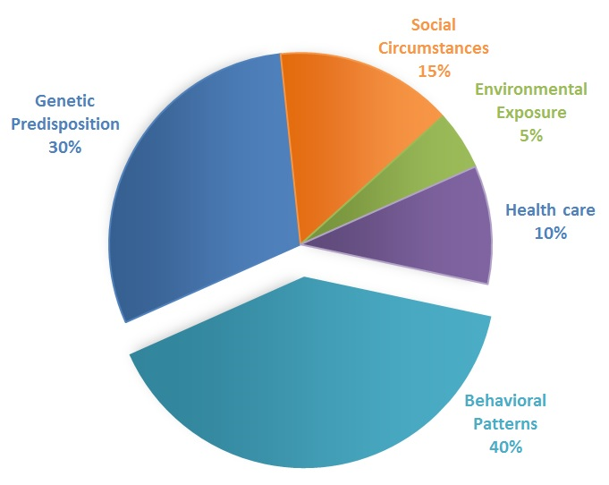
Self Management (Roles and Goals)
Notes:
Baby Ruth and peanuts

Slide 34
Risk Assessment and Behavior Impact
A role of the oral risk assessment is to achieve health goals and individualized care plans that receive buy-in from provider and patient in order to effect behavior, which comprises approximately 40% of health determinants.
Various approaches have been proposed to engage behavior with the majority of models focusing on relaying the perceived benefits of behavior change and understanding an individual’s self-efficacy.

Slide 35
Risk Assessment and Behavior Impact
Communication processes that integrated:
Goal setting
Motivational interviewing
Cooperative planning
A process for monitoring challenges and opportunities
The goal is to meet the patient on their level, create an understanding of risk factors and risky behavior, as well as, develop a shared conclusion that protective behaviors can offset or mitigate risk of disease.

Slide 36
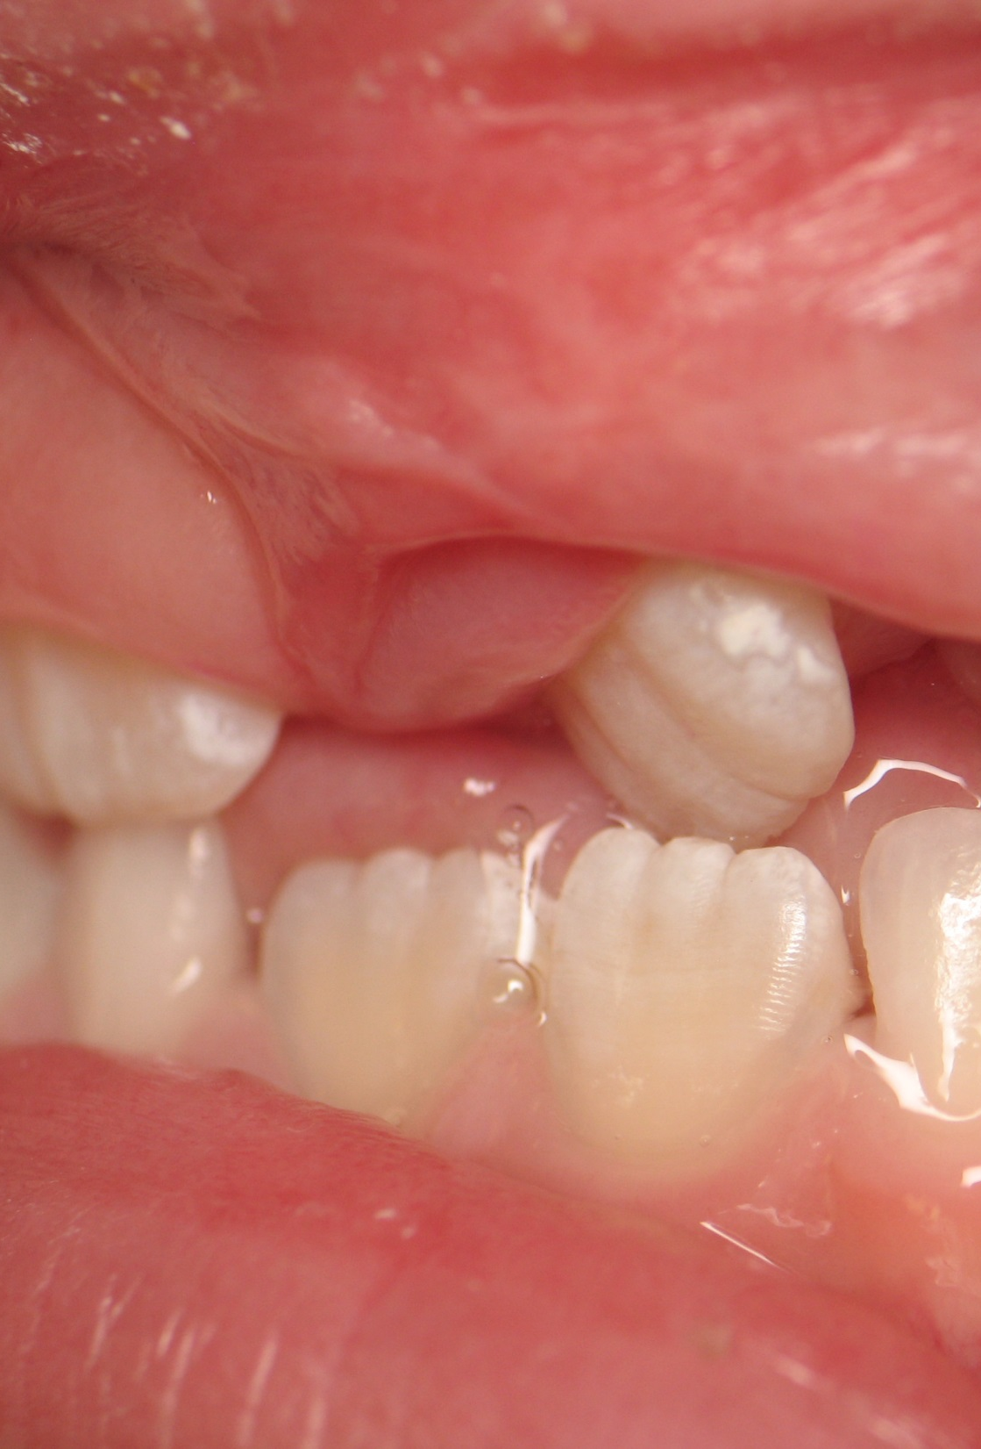
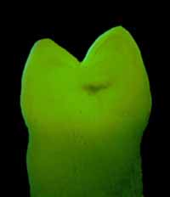
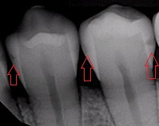
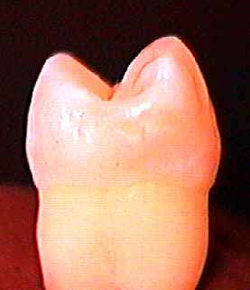
8/26/13
5/4/15
Lesions remineralize when risk factors are replaced with protective factors
-Dr. Brian Novy, DentaQuest Institute

Slide 37
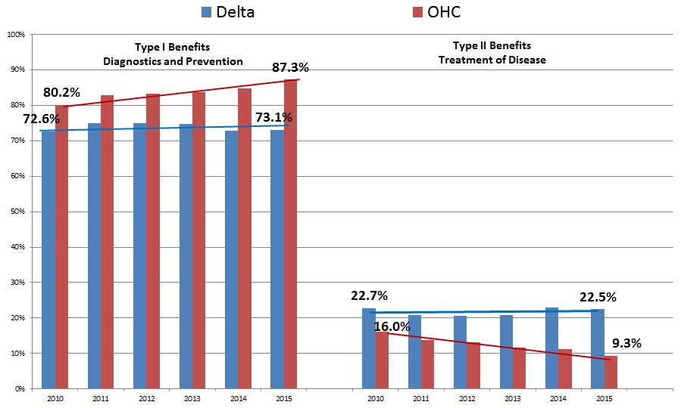
Analysis of an Early Adopter Program

Slide 38
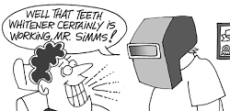
Questions & Discussion

